Slide 1
LEVEL 4 & 5 Group 2
Willoughby Axtell
Daniel Beales
Kyle Bodin
James Macleanan

Slide 2
The Requirements
A 2D game using single taps on a device screen.
Each user takes their turn individually on a single device.
The levels are symmetrical, simple and intuitive to learn and understand.
Challenge comes from beating the other player.
Appeal to a target audience of 12 year olds and under
Notes:
We are not restricting the game to under 12’s, as by our research its proved that its fairly common for games to be created for this age group, but be commonly played by adults. IE Angry birds, Doodle Jump. Plants vs zombies.
What are their interests? Looking at the games above it would be competing skill. Through either the timing of a shot or the strategy used to overpower your opponent. Does not have to have violence, although there is a theme of that present.
They Enjoy recieivng rewards as well as beating their opponent. IE Bonus Points.

Slide 3
The Concept
Simple tap, aim and shoot.
Beat your opponent to the top.
Don’t run out of time.
Get the most points
A pilot bee using a flower to launch to the top of a plant.

Slide 4
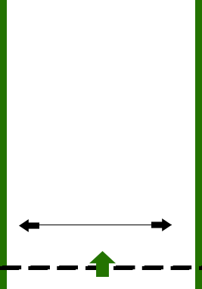

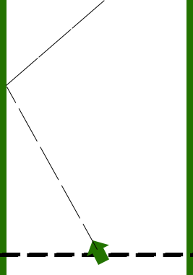
Mechanic Concept
What does the player do? The player will use a single tap at each stage to control the flower.
Slides Left to right
Rotates 180 degrees
Fire

Slide 5

The Core Game Loop

Slide 6
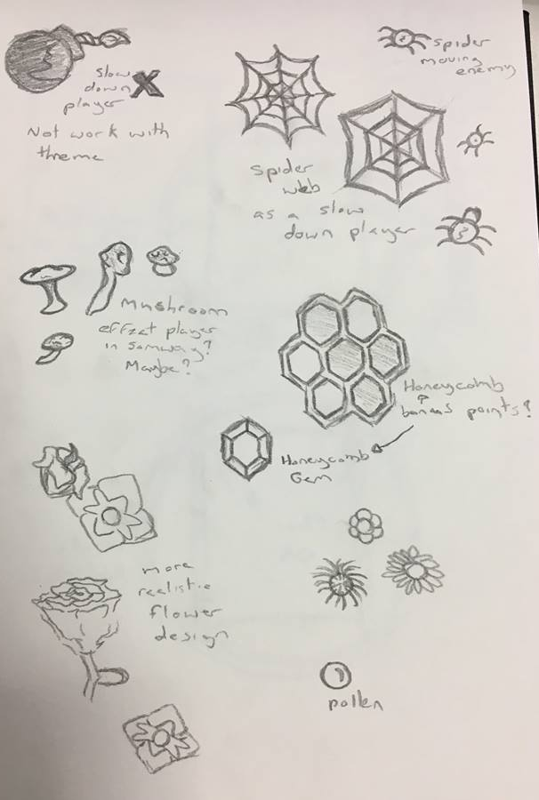
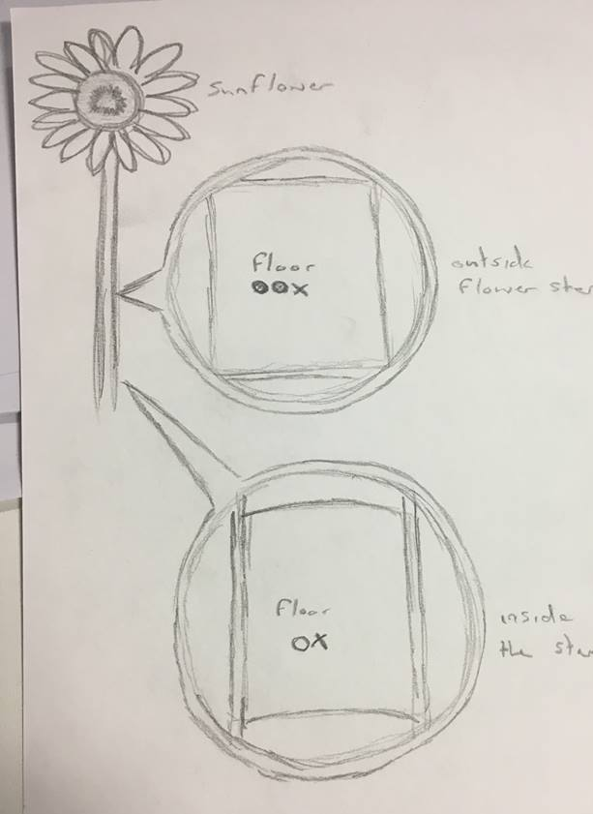
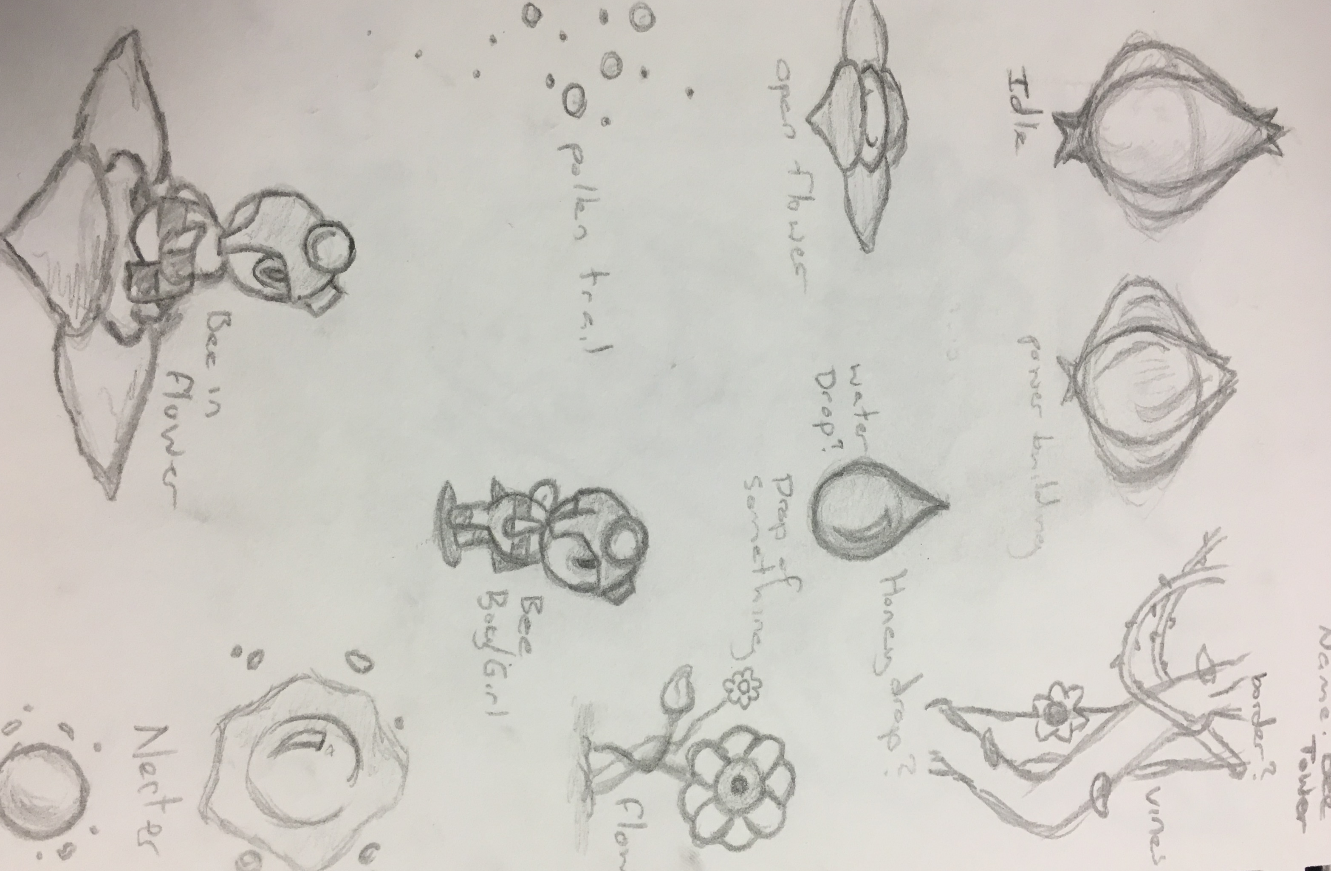
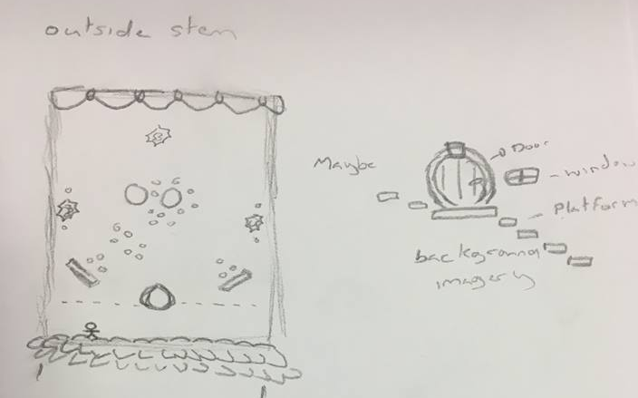
Concept Sketches

Slide 7
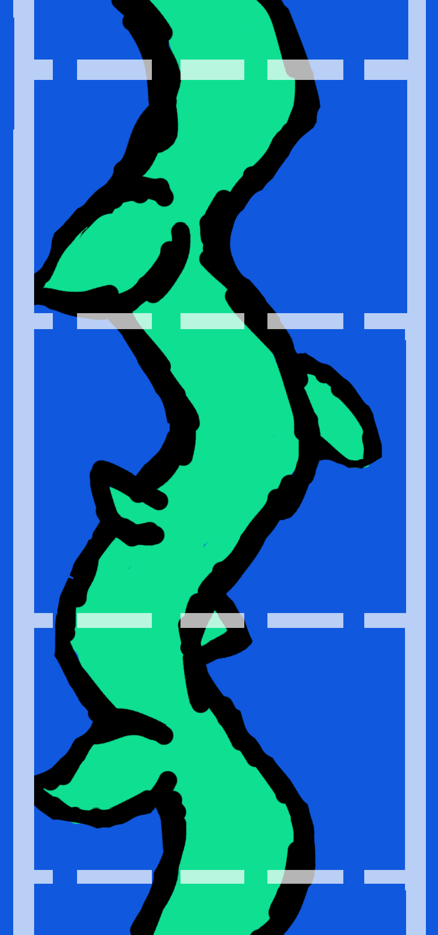

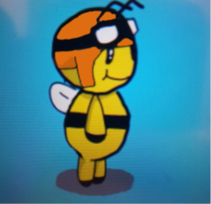
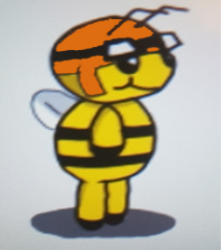


The Theme
Brightly coloured, cartoony characters and objects.
Bee Pilot
Flower Launch pad
Background
Nectar

Slide 8
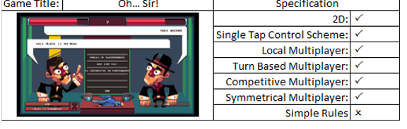
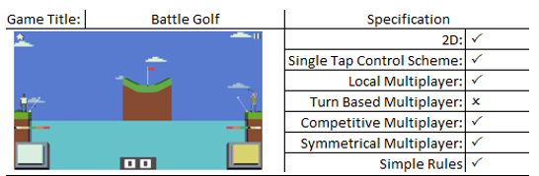
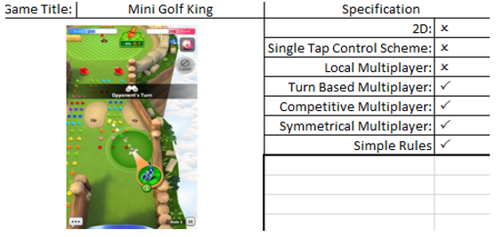
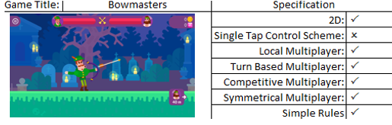
Our Research
Notes:
Multiple Games within our genre were play tested by team members,

Slide 9
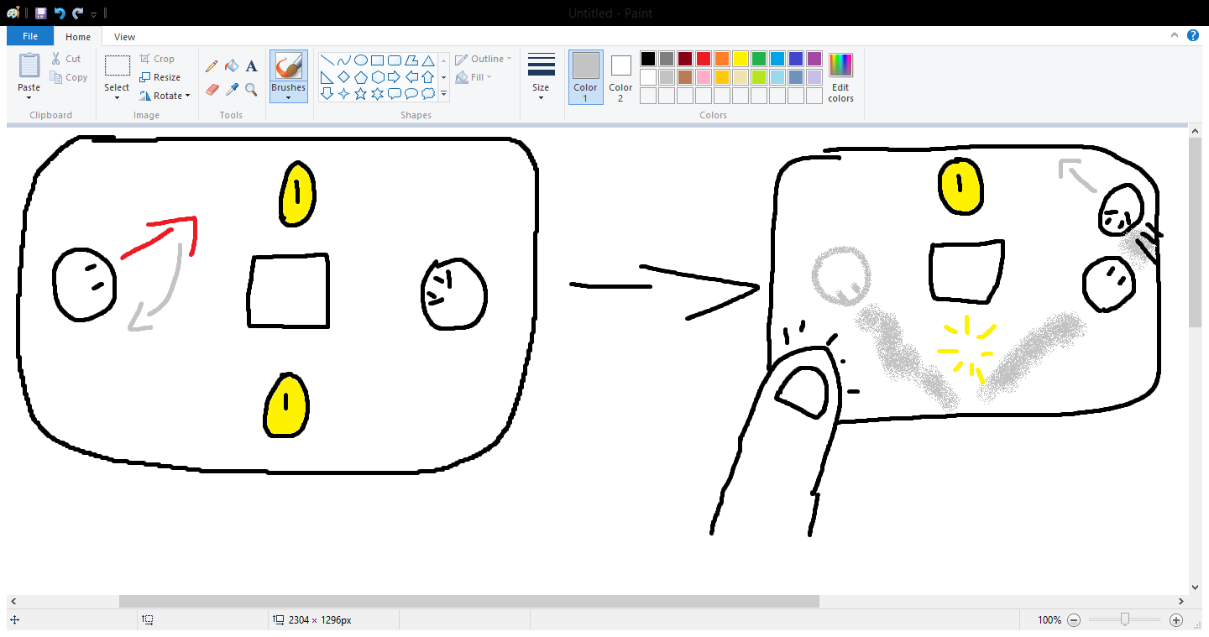
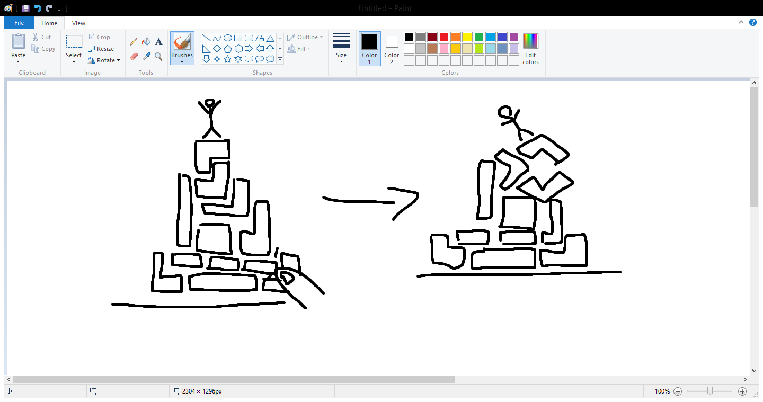

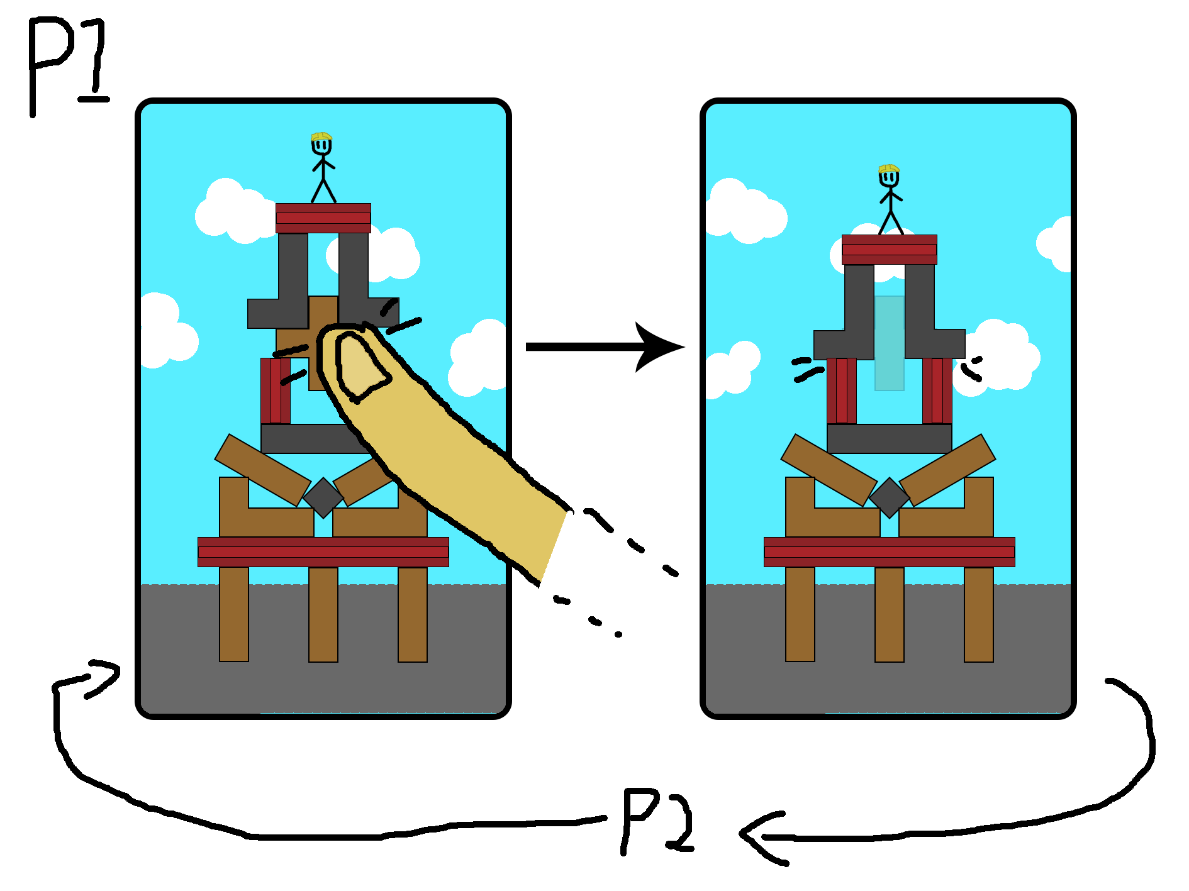
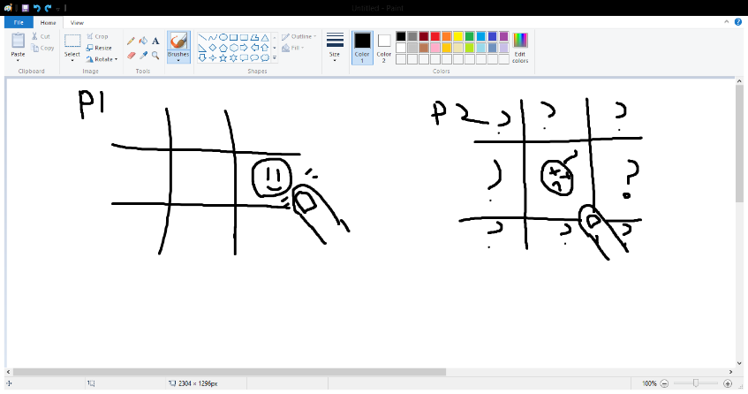
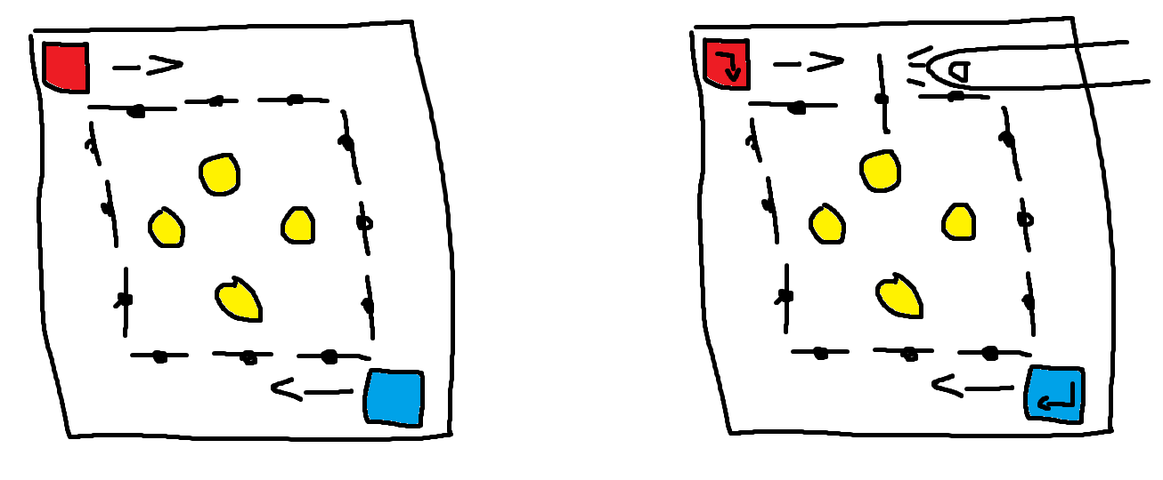
Alternate Concepts

Slide 10
Challenges
Keeping the player immersed.
Keeping the game balanced and symmetrical for both players.
Creating a difficulty to master but easy to understand and play.
Using the teams strengths appropriately.

Slide 11
Any Questions?

